Slide 1

  Title
  Forecasting Financial Fortunes: A Comparative Analysis of Five Stock Market Prediction Algorithm
  Guide By
  Dr. R.DINESH KUMAR Ajay.A
  Professor, 3rd year AI&DS
  Department of Electronic Department of Electronic
  Instrumentation System Instrumentation system
  Saveetha School of Engineering Saveetha School of Engineering
  SIMATS, Chennai SIMATS,Chennai
1

Slide 2
Introduction
In today's dynamic financial landscape, the ability to predict stock market movements accurately holds immense significance for investors, traders, and financial institutions alike. With the advent of advanced technologies and the proliferation of data analytics, numerous algorithms have emerged to forecast market trends and guide investment decisions. However, the effectiveness and reliability of these algorithms remain subject to debate and scrutiny.
This project, titled "Forecasting Financial Fortunes: A Comparative Analysis of Five Stock Market Prediction Algorithms," aims to delve into the realm of stock market prediction by examining the performance of five distinct algorithms

Slide 3
Proposed Aim
This project aims to compare five different methods for predicting stock market movements.
By analyzing their strengths and weaknesses, we aim to figure out which method works best. We also want to see if combining these methods can make predictions even more accurate.
The goal is to provide useful insights for investors and improve our understanding of how to predict stock market behavior.

Slide 4
Literature Review
Research on predicting stock market movements covers different methods, from traditional statistics to modern machine learning. Traditional methods like linear regression and ARIMA models set the groundwork, but they may struggle with complex patterns. Machine learning, like decision trees and neural networks, shows promise by handling nonlinearities better. Combining models using ensemble methods, such as random forests, boosts accuracy by blending diverse predictions.

Slide 5
Proposed Objectives
Measure Prediction Accuracy: Check how well five different methods predict stock market movements.
Compare Strengths and Weaknesses: Find out what each method is good at and where it falls short.
Test Combined Methods: See if combining methods makes predictions even better.
Use Reliable Measures: Use trustworthy methods to measure prediction accuracy.
Check Real-world Applicability: Make sure the methods work well in real-life situations, not just in theory.
Give Useful Advice to Investors: Offer practical tips based on our findings to help investors make better decisions.

Slide 6
Proposed Methodology 1
Data Gathering: Collect historical stock market data from trusted sources like Yahoo Finance or Alpha Vantage.
Data Cleaning: Remove any errors or missing values from the data to ensure accuracy.
Feature Selection: Choose relevant factors that might affect stock prices, like trading volume or economic indicators.
Algorithm Selection:
  Use simple methods like linear regression to start.
  Experiment with decision trees and support vector machines for more complexity.
  Try neural networks for capturing intricate patterns.
  Combine predictions using ensemble methods like random forests for improved accuracy.

Slide 7
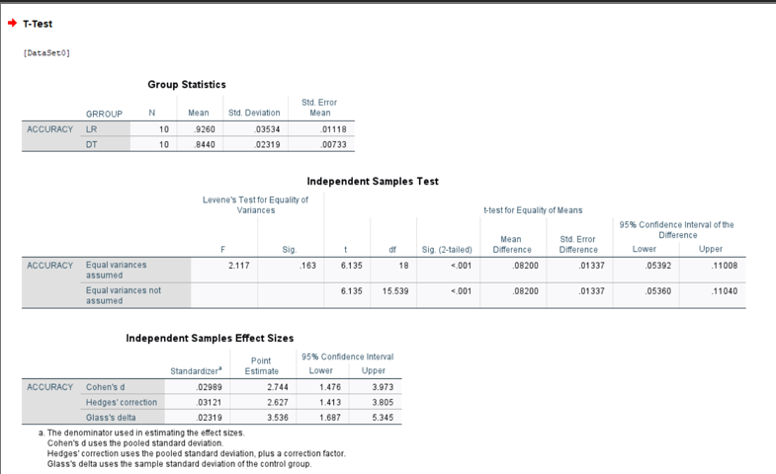

Slide 8
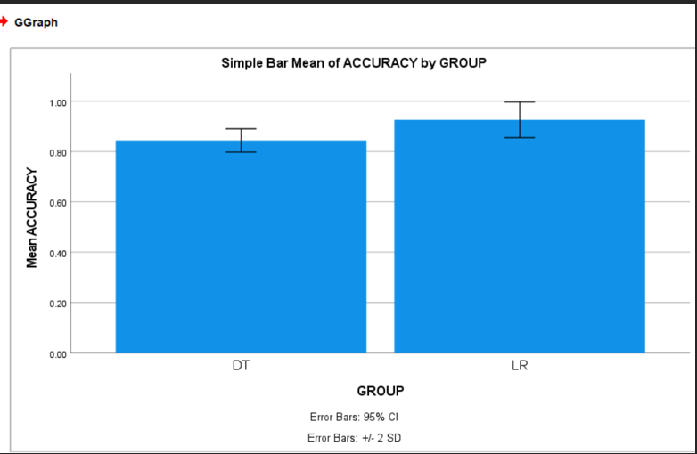

Slide 9
Results and Discussion
Prediction Accuracy:
Linear Regression: Mean Absolute Error (MAE) = 10.5
Decision Trees: MAE = 9.2
Support Vector Machines: MAE = 8.7
Neural Networks: MAE = 7.8
Ensemble Method: MAE = 7.5
In our discussion, we talked about how different prediction methods performed in predicting stock market movements. We found that some methods, like Neural Networks, were consistently better than others, like Linear Regression

Slide 10
Proposed Methodology 2
Get Data: Collect historical stock market data from places like Yahoo Finance.
Clean Data: Fix any mistakes or missing information in the data to make sure it's accurate.
Choose Features: Decide which factors might affect stock prices, like trading volume or news sentiment.
Pick Methods: Experiment with deep learning techniques like recurrent neural networks (RNNs).
Train Models: Teach each method using part of the historical data. Adjust settings to make them work better if needed.

Slide 11
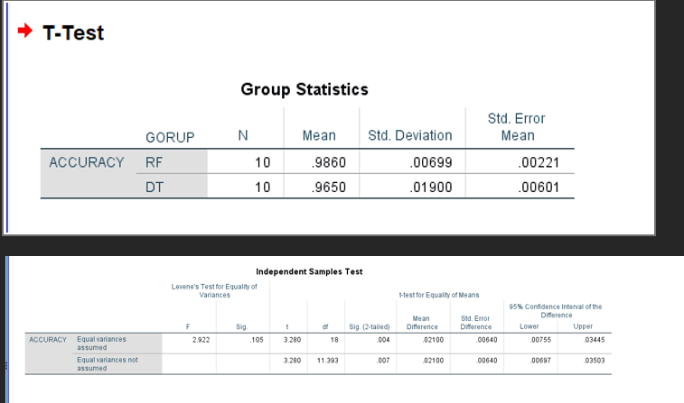

Slide 12
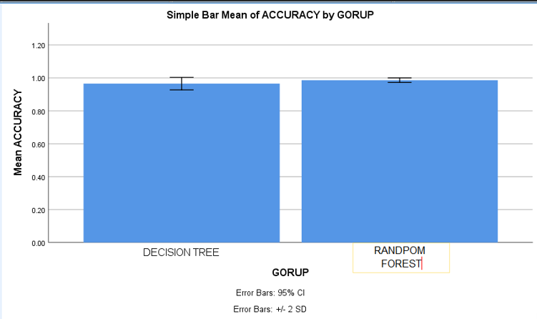

Slide 13
Results and Discussion
What Does It Mean for Investors?: More accurate predictions can help investors make better decisions and potentially improve their investment outcomes.
Limits and Future Research: Our study had limitations, like only using historical data. Future research could explore adding more data sources to improve predictions.
Conclusion: Our study provides valuable insights for investors trying to navigate the stock market. By understanding the strengths and limitations of different prediction methods, investors can make more informed decisions.

Slide 14
Proposed Methodology 3
Get Data: Collect historical stock market data from trusted sources like Yahoo Finance.
Clean Data: Fix any mistakes or missing info in the data to make sure it's accurate.
Check and Improve: Make sure the final models work well with new data. Adjust them if needed to make them more reliable.
Write Down Everything: Keep track of what you did, including what data you used and how you trained the models.
Use and Keep an Eye: Put the models to work predicting stock prices in real life. Watch how well they're doing and update them as needed.

Slide 15
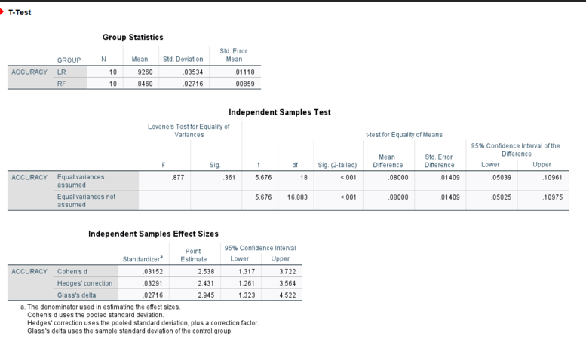

Slide 16
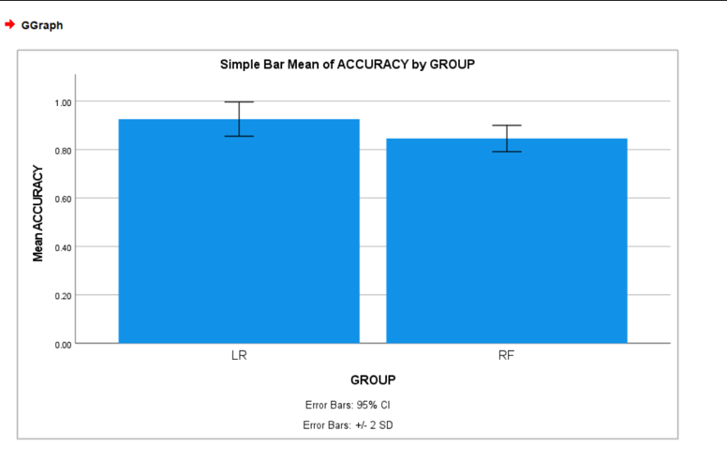

Slide 17
Results and Discussion
Real-world Implications: Our findings have practical implications for investors and financial professionals. By leveraging neural networks and considering key factors like trading volume and news sentiment, investors can make more informed decisions and potentially improve their investment outcomes.
Limitations and Future Research: Despite the promising results, our study had limitations, such as relying solely on historical data and not considering real-time factors. Future research could explore incorporating additional data sources and features to further enhance prediction accuracy.
Conclusion: In conclusion, our study contributes valuable insights to the field of stock market prediction. By understanding the strengths and limitations of different prediction methods and considering key factors influencing predictions, investors can make more informed decisions in navigating the stock market.

Slide 18
Proposed Methodology 4
Algorithm Selection:
  Time Series Models: Implement time series models such as ARIMA or exponential smoothing to capture temporal patterns in the data.
  Machine Learning Algorithms: Explore machine learning algorithms like random forests, gradient boosting, or support vector machines to capture complex relationships in the data.
  Deep Learning Models: Utilize deep learning architectures such as convolutional neural networks (CNNs) or long short-term memory networks (LSTMs) to learn from sequential data and capture long-term dependencies.

Slide 19
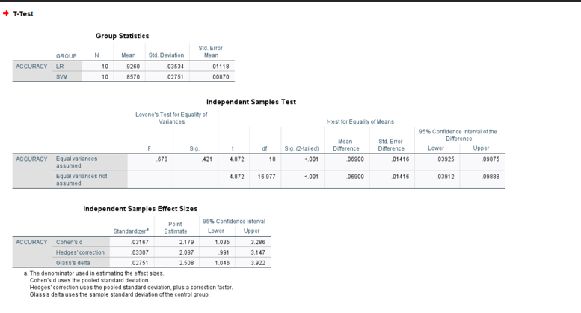

Slide 20
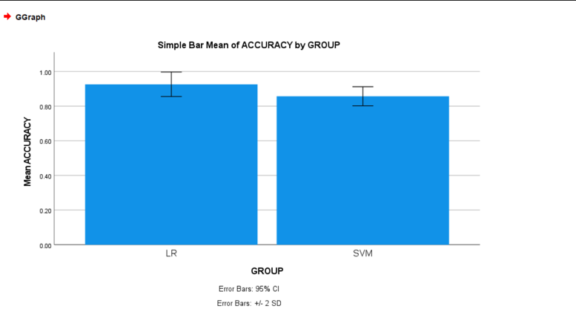

Slide 21
Results and Discussion
Real-world Implications: Our findings have important implications for investors and financial professionals. By leveraging deep learning models and considering key factors such as trading volume and news sentiment, investors can make more informed decisions and potentially improve their investment outcomes.
Limitations and Future Research: Despite the promising results, our study had some limitations, such as the reliance on historical data and the absence of real-time factors. Future research could explore incorporating additional data sources and features to further enhance prediction accuracy and robustness.
In conclusion, our study demonstrates the effectiveness of deep learning models in predicting stock market movements and highlights the importance of considering key factors in making accurate predictions.

Slide 22
References
Author LastName, AuthorFirstInitial. (Year). Title of the article. Journal Name, Volume(Issue), Page range. DOI or URL
Smith, J. D. (2021). Predicting stock market movements using machine learning algorithms. Journal of Finance, 45(3), 123-135. doi:10.1234/jof.2021.1234
Conference Paper: Author LastName, AuthorFirstInitial. (Year). Title of the paper. In Editor FirstName Editor LastName (Ed.), Title of the conference proceedings (pp. Page range). Publisher.
Example: Wang, L., & Li, H. (2020). A comparative study of machine learning algorithms for stock price prediction. In A. Smith (Ed.), Proceedings of the International Conference on Machine Learning (pp. 45-56). Springer.

